Slide 1
自我介紹 (niziima Lize)

Slide 2
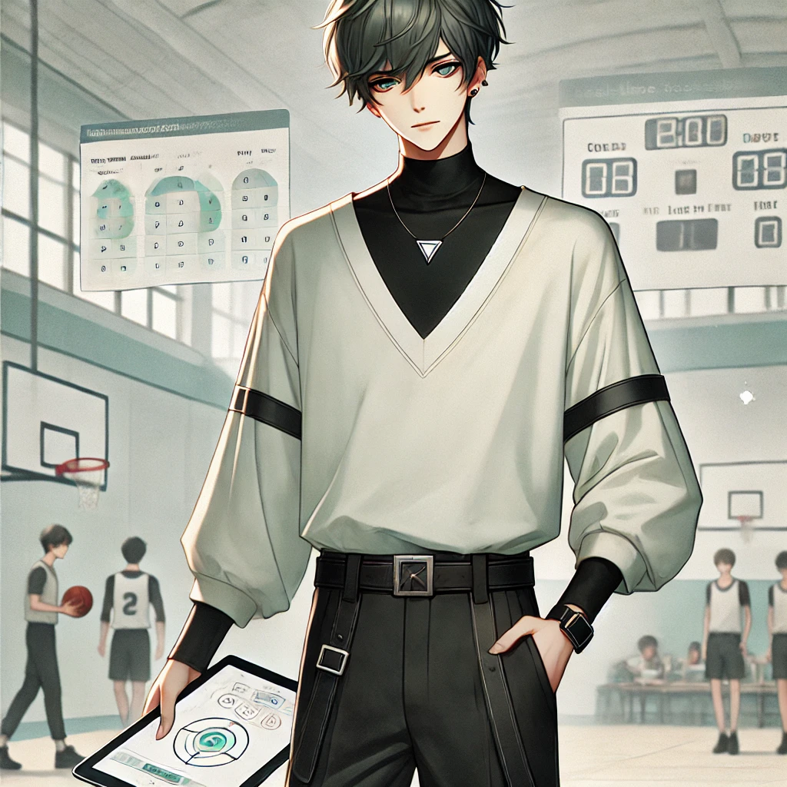
1.目標
Notes:
Generate an anime-style character with a minimalist yet stylish appearance. The character is a young man with short, dark gray green, slightly tousled hair and layered bangs that partially cover his forehead. He wears a loose-fitting white long-sleeved top with a V-neck and black high-neck inner layer, adding depth to his outfit. The sleeves have black straps as additional detail. He wears black pants with a sleek, modern cut and a black belt with a metallic triangular buckle at the center. The character completes the look with black leather shoes. The background should be a soft pastel color with a few sparkles for a subtle, dreamy effect. 畫面中只要一個主角 其他人物在背景 產出以下故事劇情的場景圖 我決定參加校園籃球聯賽，並且同時設計一款能幫助球隊分析比賽數據的應用程式。我希望這個應用能夠實時提供戰術建議，提升我們球隊的整體表現，並帶領我們奪冠。

Slide 3
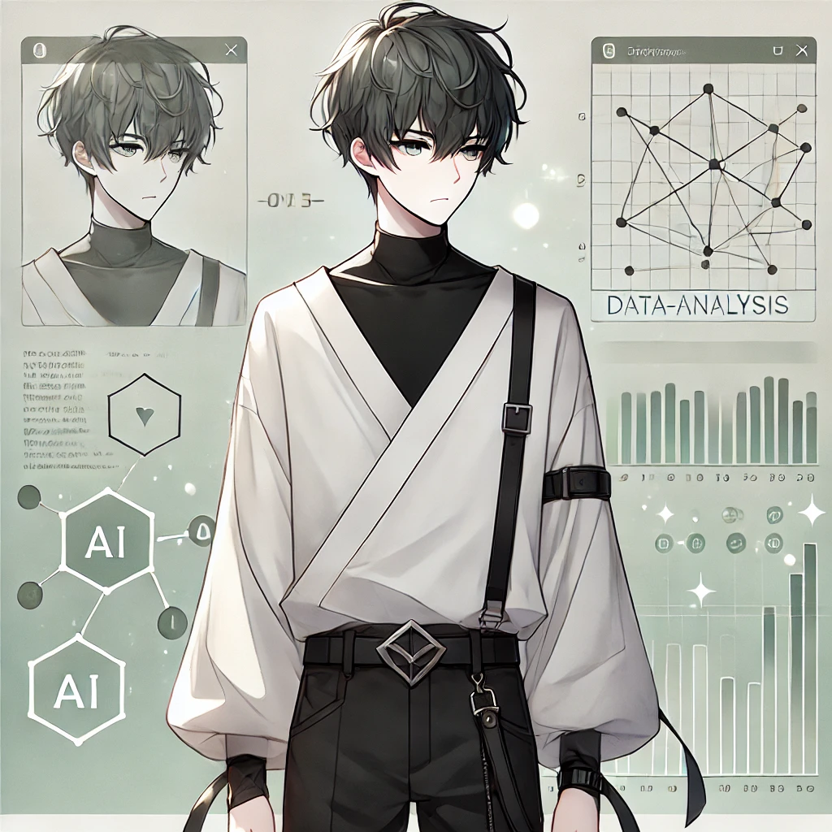
2.阻礙
Notes:
Generate an anime-style character with a minimalist yet stylish appearance. The character is a young man with short, dark gray green, slightly tousled hair and layered bangs that partially cover his forehead. He wears a loose-fitting white long-sleeved top with a V-neck and black high-neck inner layer, adding depth to his outfit. The sleeves have black straps as additional detail. He wears black pants with a sleek, modern cut and a black belt with a metallic triangular buckle at the center. The character completes the look with black leather shoes. The background should be a soft pastel color with a few sparkles for a subtle, dreamy effect. 畫面中只要一個主角 其他人物在背景, 正方形長寬比 我決定不放棄，開始通過大量閱讀研究文獻、向教授請教、以及參加技術研討會來加強自己的技術能力。我還利用每天清晨跑步的時間思考問題，運動讓我保持清醒和專注，最終逐步克服了這些技術難題。

Slide 4
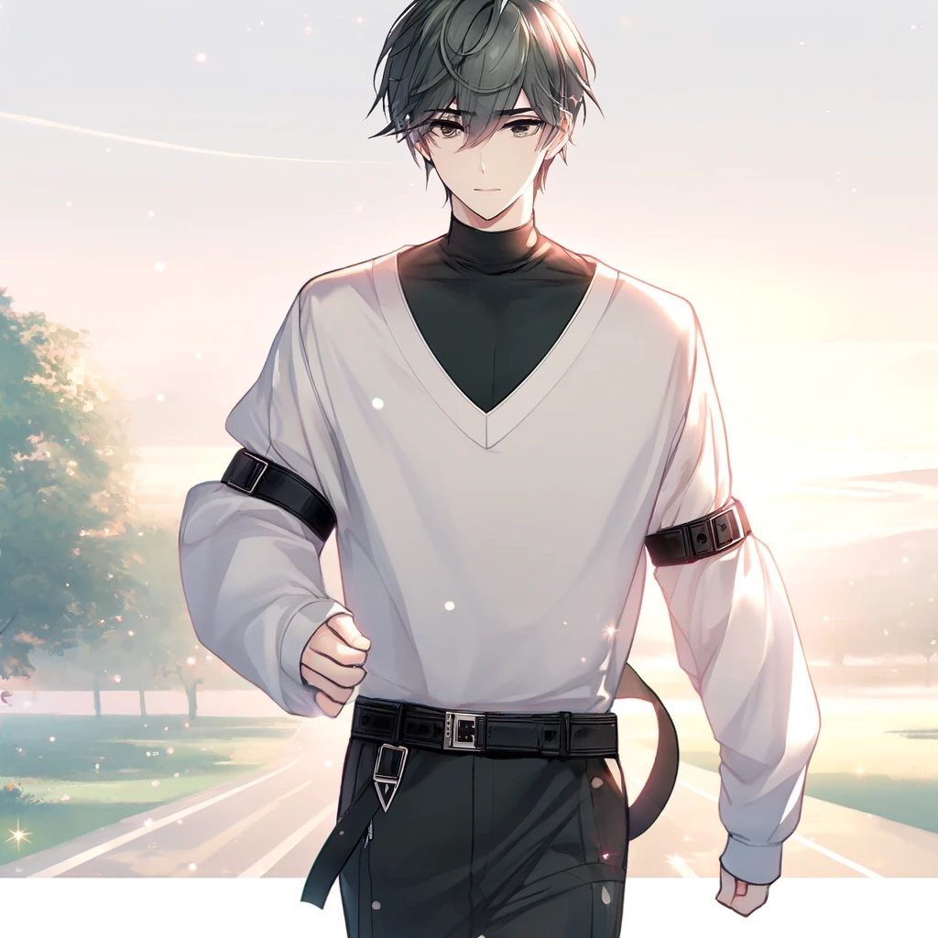
3.努力
Notes:
Generate an anime-style character with a minimalist yet stylish appearance. The character is a young man with short, dark gray green, slightly tousled hair and layered bangs that partially cover his forehead. He wears a loose-fitting white long-sleeved top with a V-neck and black high-neck inner layer, adding depth to his outfit. The sleeves have black straps as additional detail. He wears black pants with a sleek, modern cut and a black belt with a metallic triangular buckle at the center. The character completes the look with black leather shoes. The background should be a soft pastel color with a few sparkles for a subtle, dreamy effect. 畫面中只要一個主角 其他人物在背景, 正方形長寬比 每天清晨跑步的圖片

Slide 5
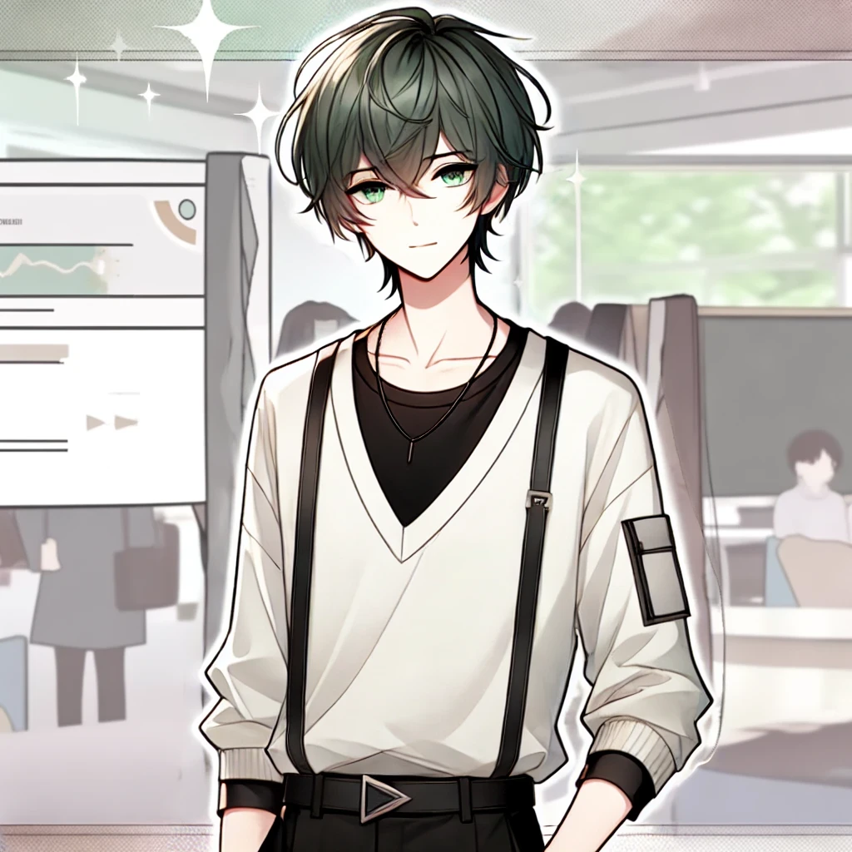
4.結果
Notes:
Generate an anime-style character with a minimalist yet stylish appearance. The character is a young man with short, dark gray green, slightly tousled hair and layered bangs that partially cover his forehead. He wears a loose-fitting white long-sleeved top with a V-neck and black high-neck inner layer, adding depth to his outfit. The sleeves have black straps as additional detail. He wears black pants with a sleek, modern cut and a black belt with a metallic triangular buckle at the center. The character completes the look with black leather shoes. The background should be a soft pastel color with a few sparkles for a subtle, dreamy effect. 畫面中只要一個主角 其他人物在背景, 正方形長寬比 幫我繪製自信滿滿地準備在校內的創新比賽上展示應用程式的作品

Slide 6
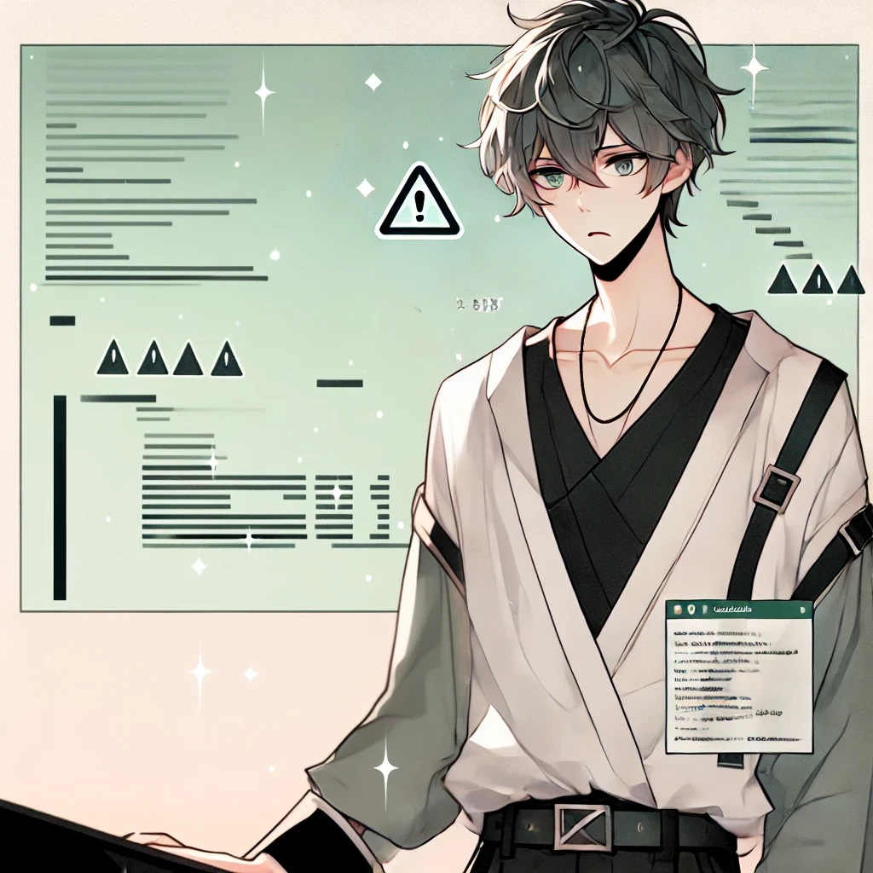
5.意外
Notes:
Generate an anime-style character with a minimalist yet stylish appearance. The character is a young man with short, dark gray green, slightly tousled hair and layered bangs that partially cover his forehead. He wears a loose-fitting white long-sleeved top with a V-neck and black high-neck inner layer, adding depth to his outfit. The sleeves have black straps as additional detail. He wears black pants with a sleek, modern cut and a black belt with a metallic triangular buckle at the center. The character completes the look with black leather shoes. The background should be a soft pastel color with a few sparkles for a subtle, dreamy effect. 畫面中只要一個主角 其他人物在背景, 正方形長寬比 因應用程式有bug導致焦慮無比的圖片

Slide 7
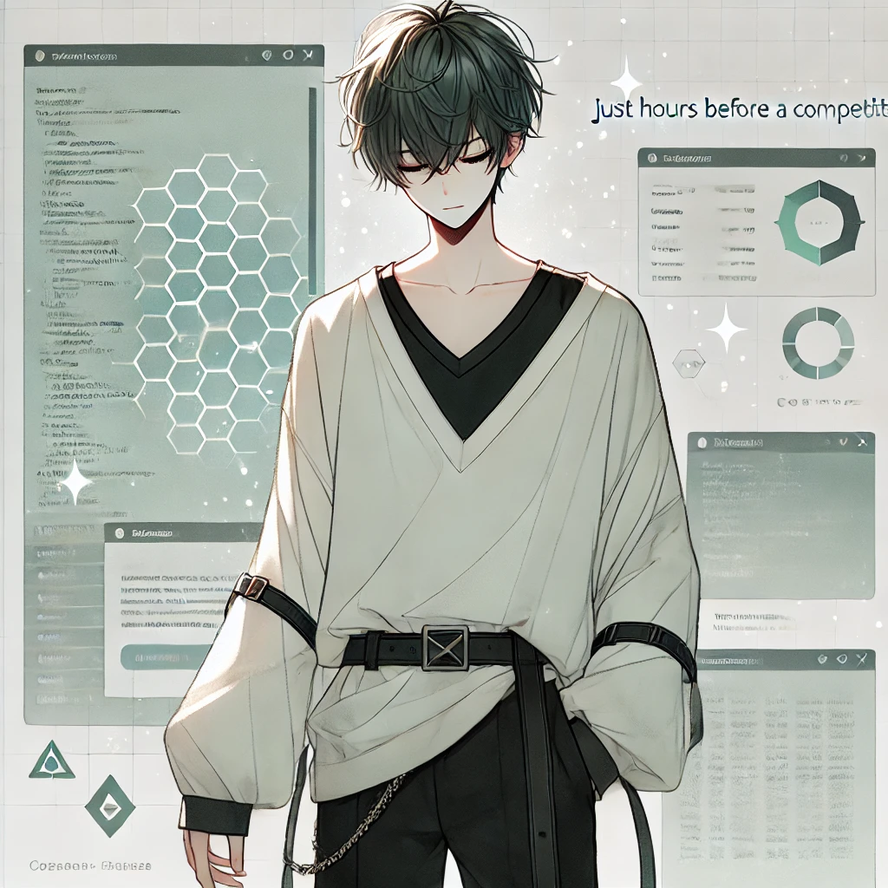
6.轉彎
Notes:
Generate an anime-style character with a minimalist yet stylish appearance. The character is a young man with short, dark gray green, slightly tousled hair and layered bangs that partially cover his forehead. He wears a loose-fitting white long-sleeved top with a V-neck and black high-neck inner layer, adding depth to his outfit. The sleeves have black straps as additional detail. He wears black pants with a sleek, modern cut and a black belt with a metallic triangular buckle at the center. The character completes the look with black leather shoes. The background should be a soft pastel color with a few sparkles for a subtle, dreamy effect. 畫面中只要一個主角 其他人物在背景, 正方形長寬比 幫我繪製但在壓力下，我靜下心來，反覆測試和修正，終於在比賽前幾小時解決了問題。這次意外讓我學到，無論是運動還是程式開發，關鍵時刻的冷靜和堅持往往能決定結果。

Slide 8
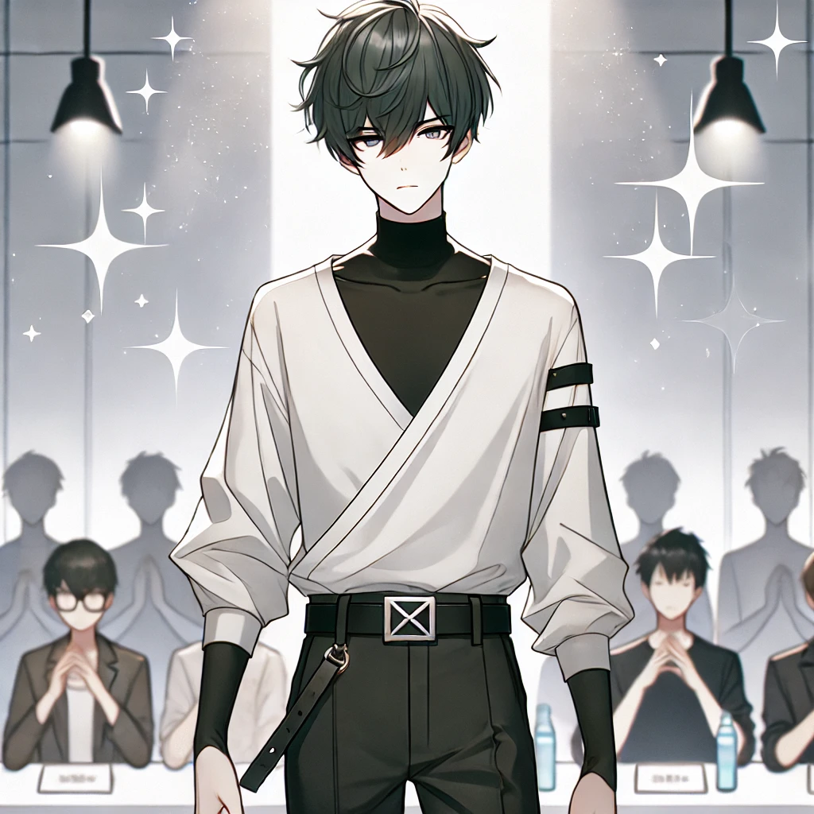
7.結局
Notes:
Generate an anime-style character with a minimalist yet stylish appearance. The character is a young man with short, dark gray green, slightly tousled hair and layered bangs that partially cover his forehead. He wears a loose-fitting white long-sleeved top with a V-neck and black high-neck inner layer, adding depth to his outfit. The sleeves have black straps as additional detail. He wears black pants with a sleek, modern cut and a black belt with a metallic triangular buckle at the center. The character completes the look with black leather shoes. The background should be a soft pastel color with a few sparkles for a subtle, dreamy effect. 畫面中只要一個主角 其他人物在背景, 正方形長寬比 在比賽中，我的作品獲得了評審的高度評價，最終拿下了冠軍。

